Slide 1

5 Ideas

Slide 2
5 Ideas
Idea 1: In the last 5 years, the number of articles and social media posts about glassware has increased by 46.42% CAGR.
Idea 2: Sustainability and recycling are important to consumers when buying products. Glass is a good choice, and consumers look for sustainability, quality and performance as their top 3 features based on 186k social media and news articles in 2021.
Idea 3: Across the generations, Gen Z and Millennials are the most cost and recycling conscious. Gen Z and Millennials look for reusable glass products when purchasing consumer goods.
Idea 4: Yogurt, water (flat and sparkling), RTD, cooking sauces and oils are the top opportunities for new consumer products glassware products.
Idea 5: Wine, beer, coffee and tea are the top beverage products that consumers purchase in glass. Tweets are growing at 7.7% CAGR in the last 5 Years.

Slide 3
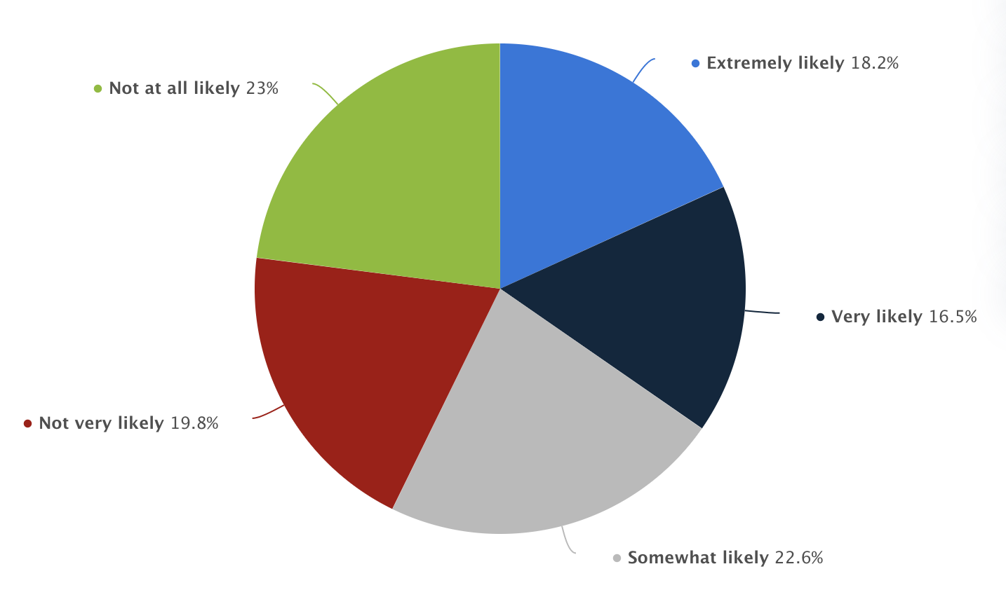
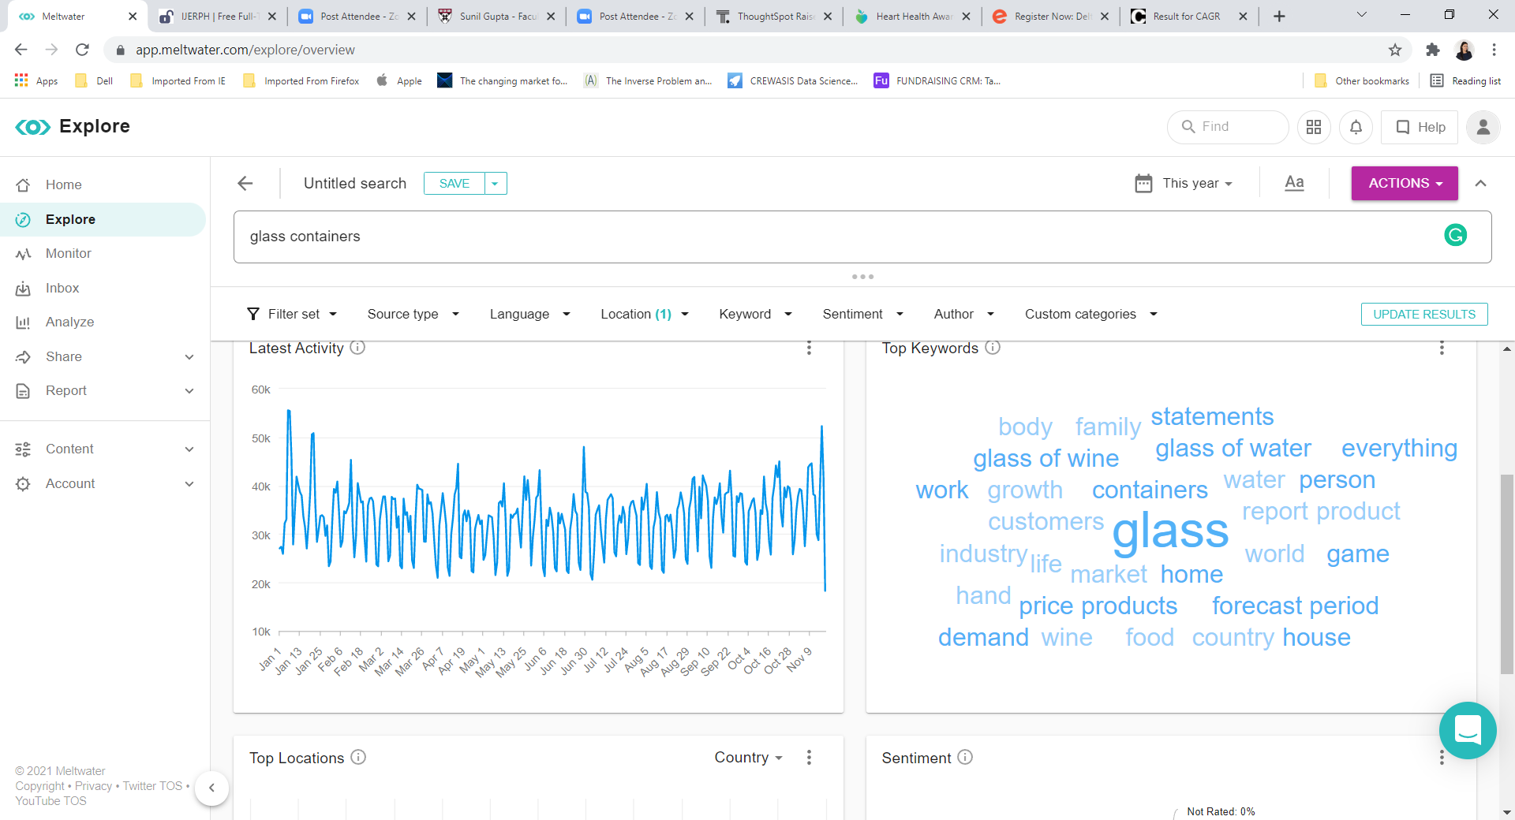
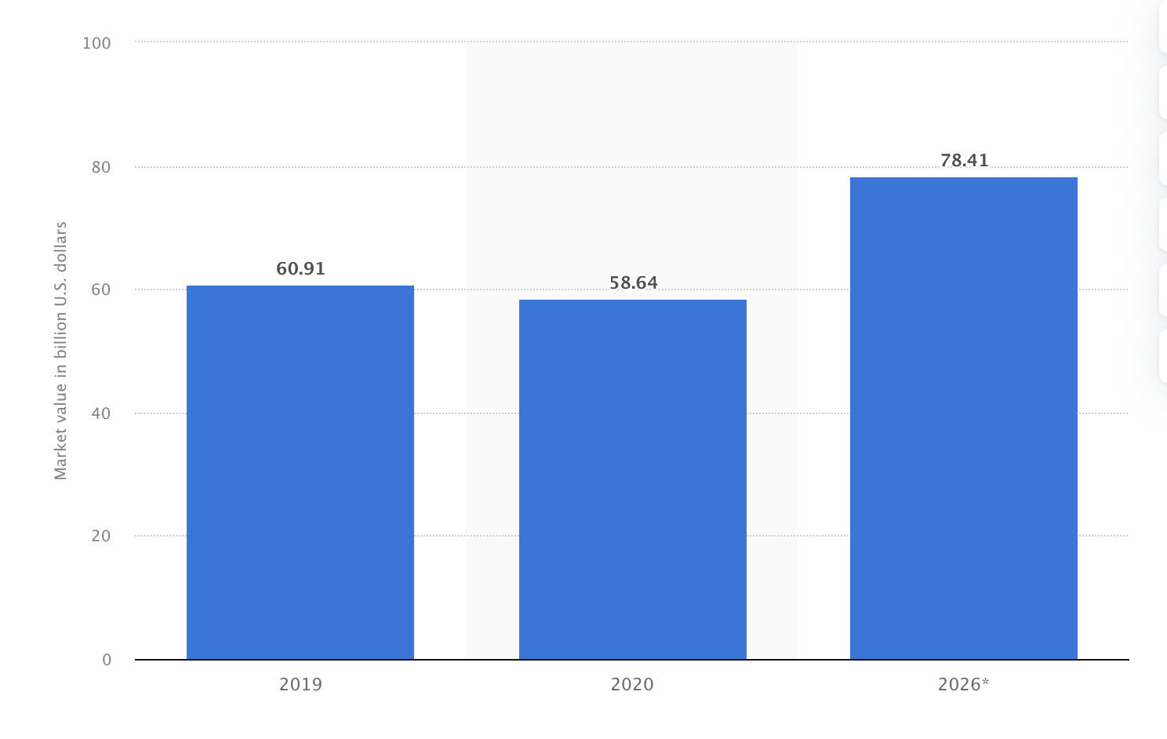
Idea 1:
In the last 5 years, the number of articles and social media posts about glassware has increased by +46.42% CAGR.
Projected market value of glass containers and bottles
+46.42% CAGR
2021 Word Cloud Based on 10MM US Social Media and News Articles About Glassware
Projected market value of glass containers and bottles in billions.
Based on analysis of 10MM US articles and social media posts about glassware home (307K), containers (252K), water (199K), wine (149K), products (145K), price (123K) and work (79K) are the top keywords.
The number of articles and social media posts about glassware has increased by 8.25% CAGR since 2017.
Market value of glass containers and bottles is projected grow to ~78B by 2026.
18.2% of US consumers are extremely likely to make a large beverage-ware purchase in the next 12 months.
Source: Statista and Social Media analysis

Slide 4
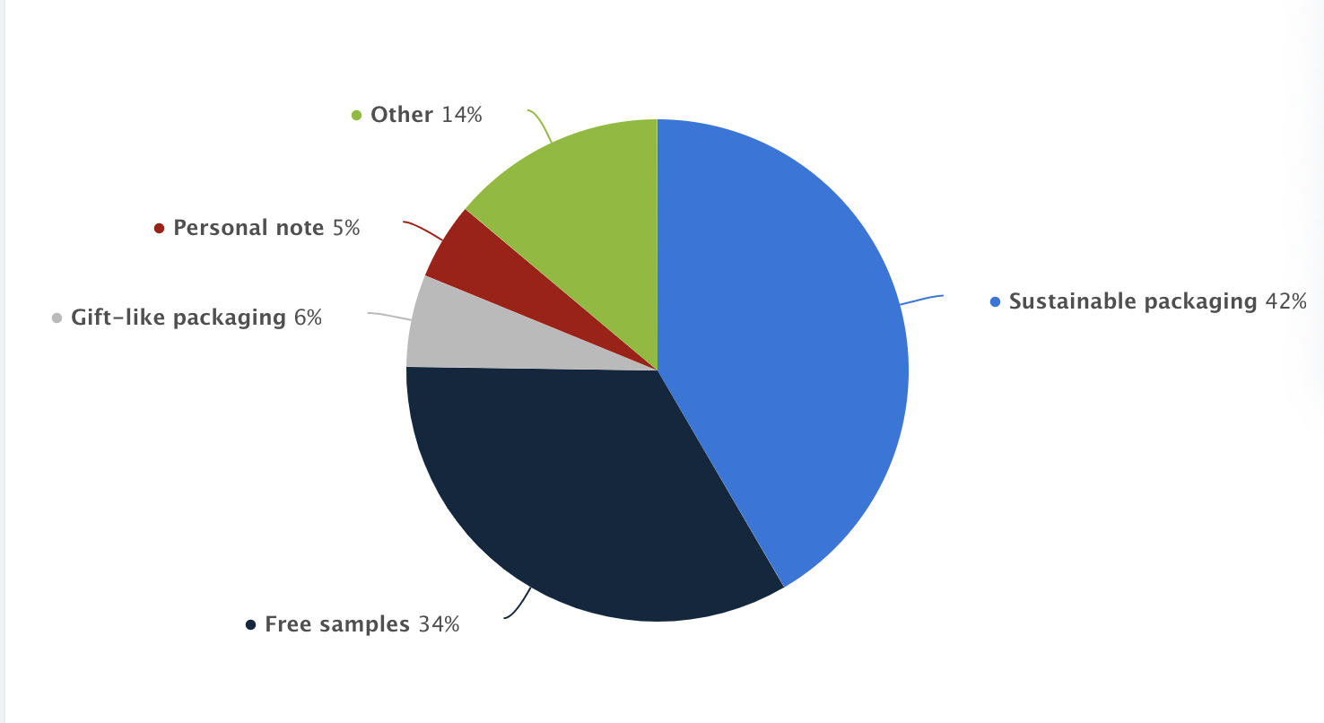
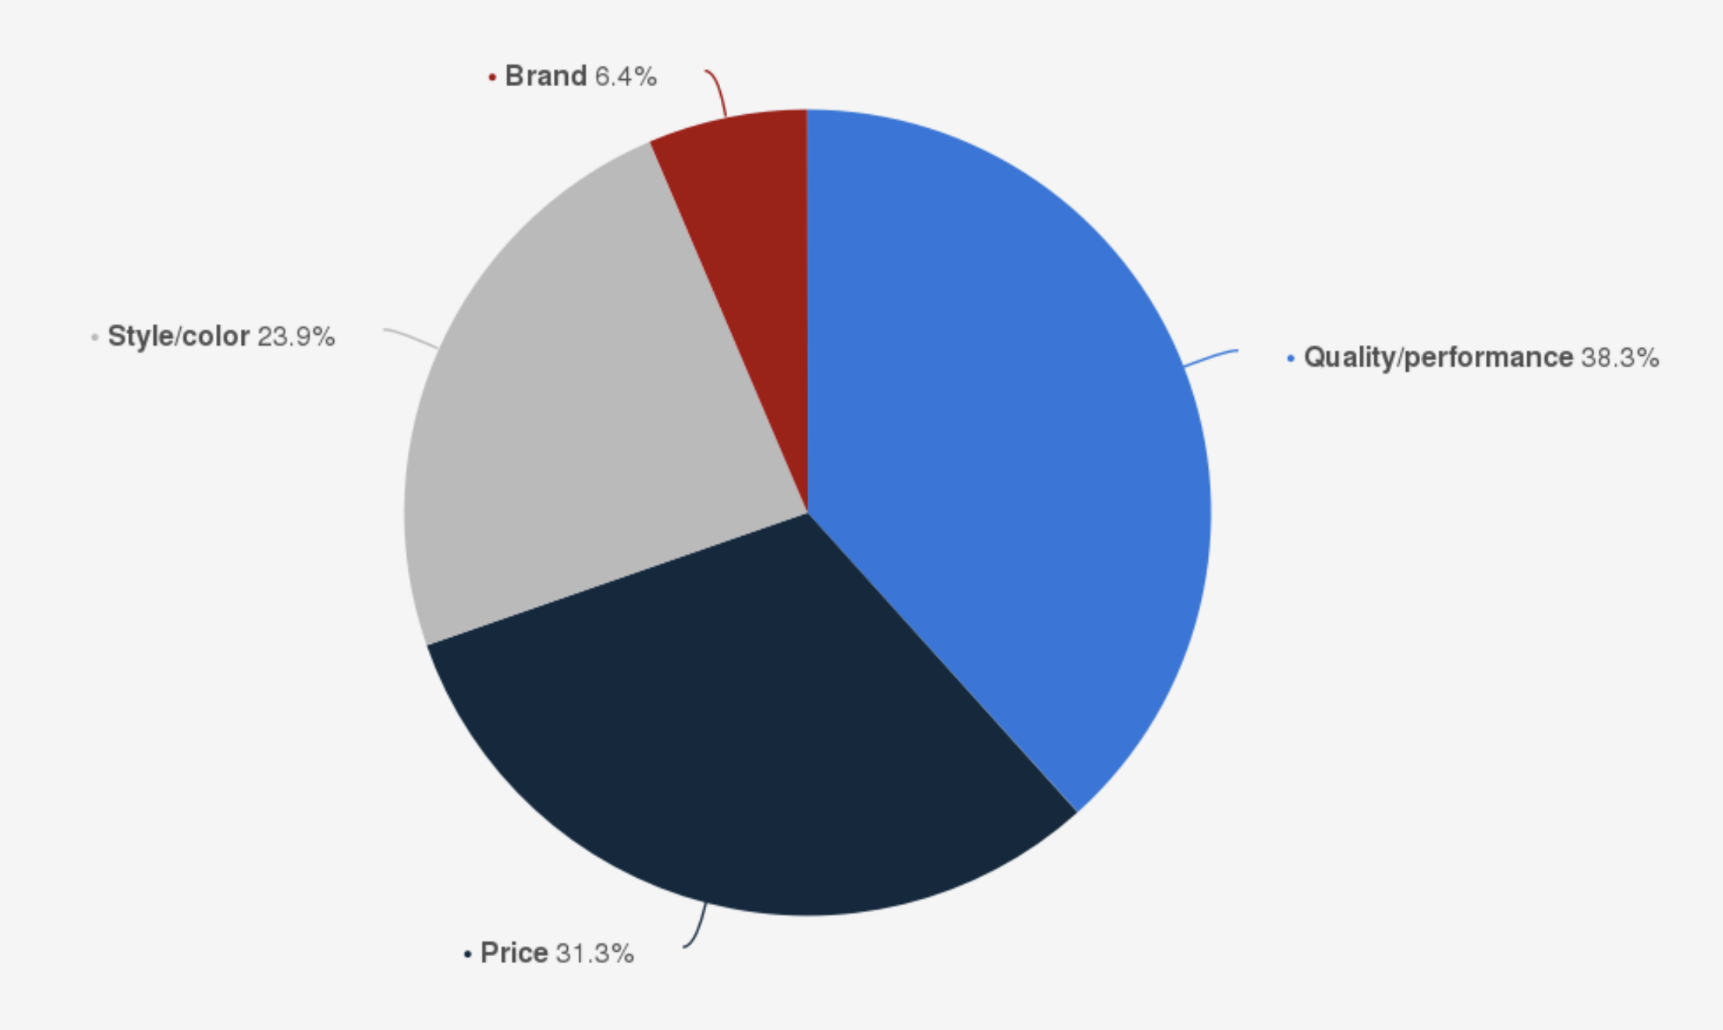
Idea 2:
Sustainability and recycling are important to consumers when buying products. Glass is a good choice, and consumers look for sustainability, quality and performance as their top 3 features based on 186k social media and news articles in 2021.
42% of consumers look for sustainable packaging while purchasing glass beverage-ware.
Most talked about feature of glass is performance, followed by premium and sustainability.
38% of consumers look for quality/performance in glass beverage-ware and 31% look for price.
Source: Statista and Social Media analysis

Slide 5
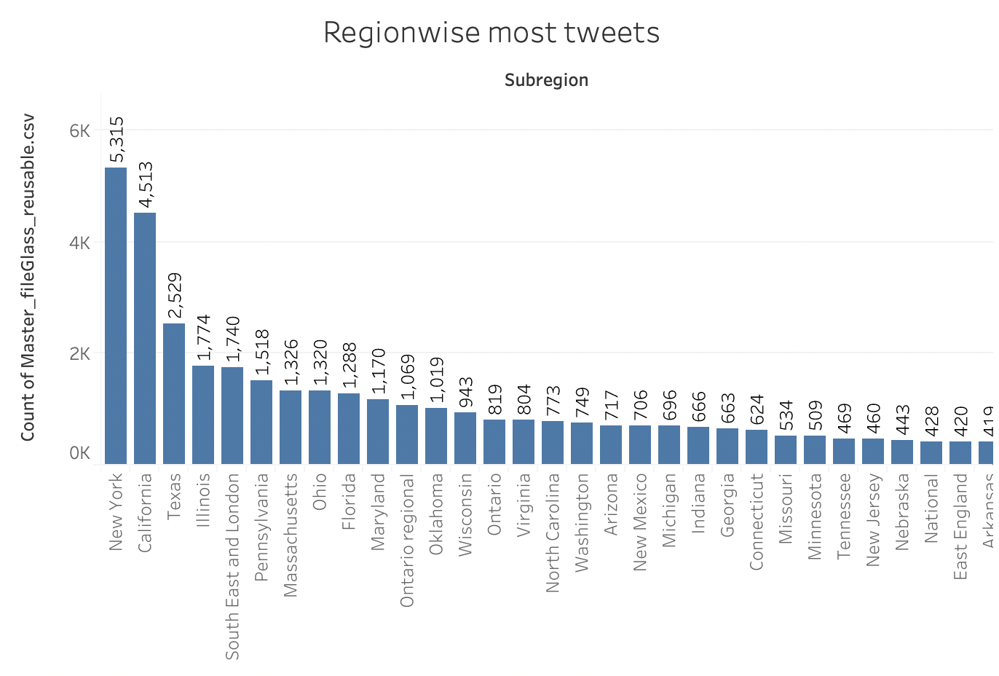
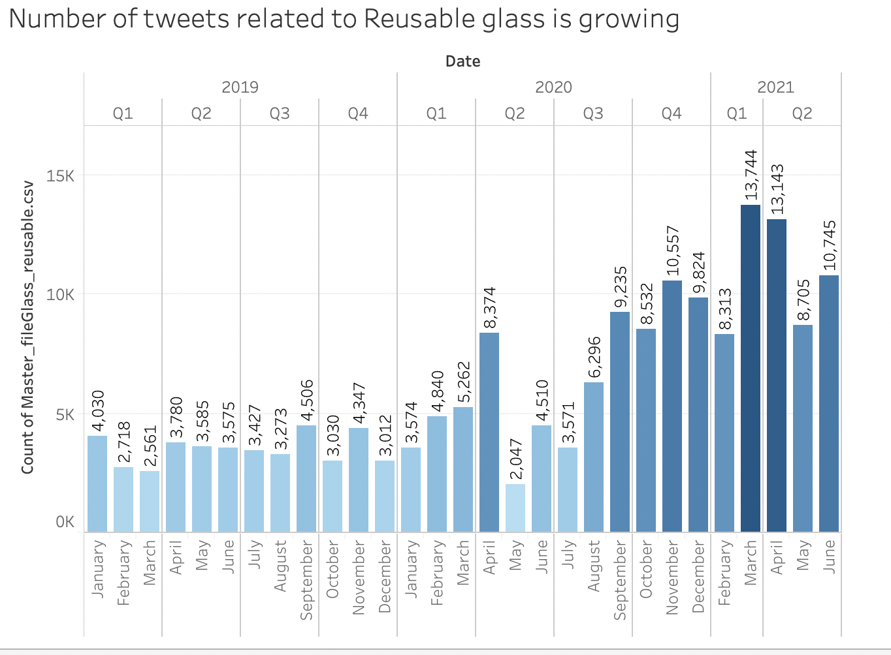
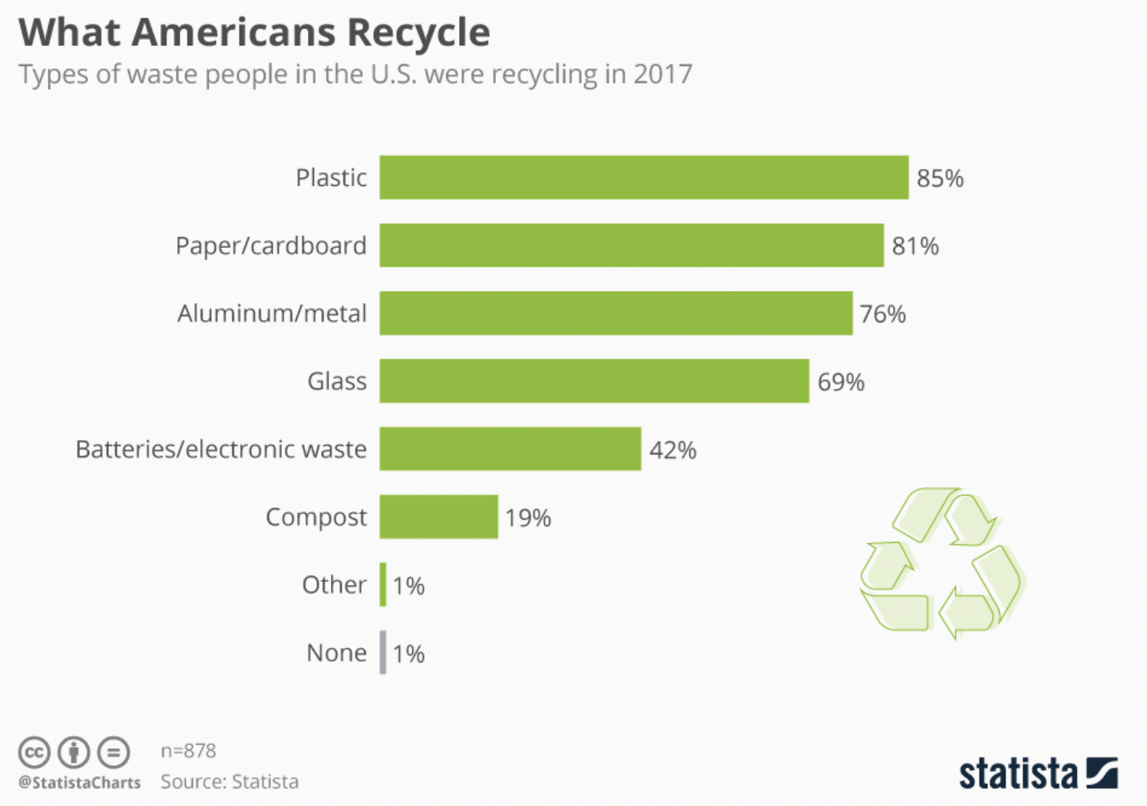
Idea 3:
Across the generations, Gen Z and Millennials are the most cost and recycling conscious. Gen Z and Millennials look for reusable glass products when purchasing consumer goods.
Most tweets for reusable glass are coming from New York(5315) , California(4513), Texas(2529) and Illinois(1740). While New York is the 5th largest state for recycling, Maine has highest recycling rate.
Glass is among top most recycled product in USA. Tweets about reusable glass increased from ~4k in January 2018 to 10k in June 2021.
Source: The analysis are based on 173,116 social media posts across the last 30 months and data from Statista.
Source: Statista.

Slide 6
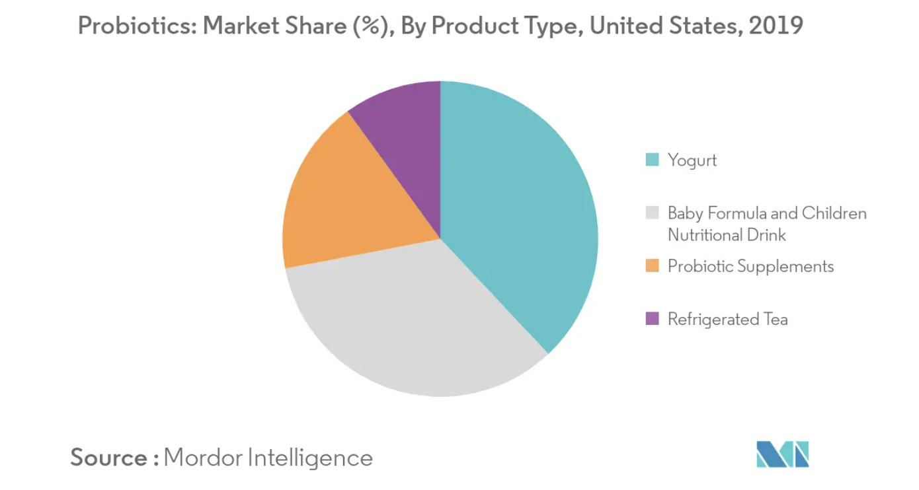
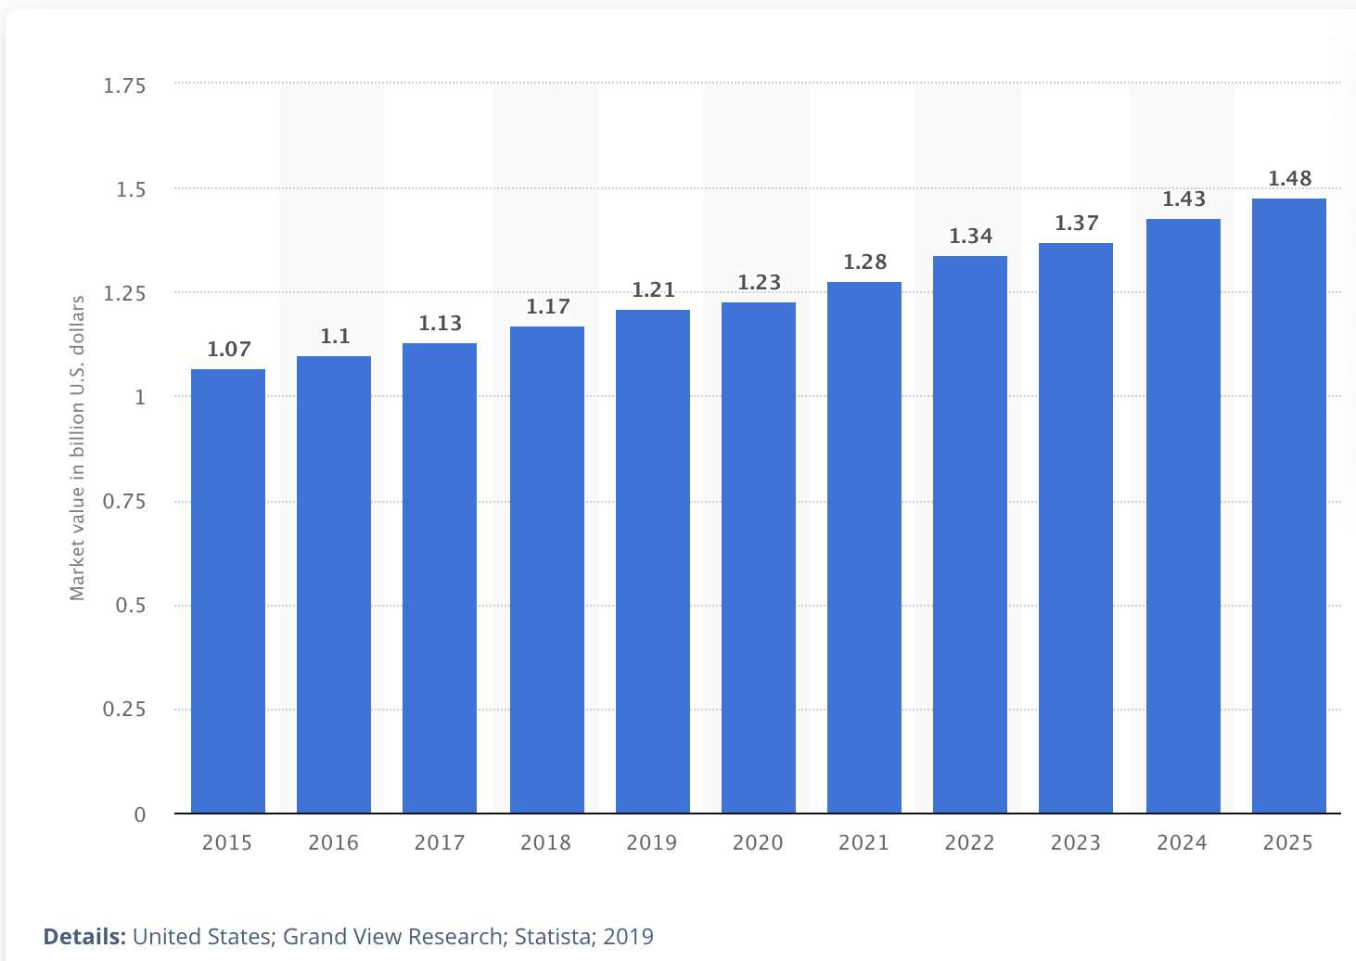
Idea 4:
Yogurt, water (flat and sparkling), RTD, cooking sauces and oils are the top opportunities for new consumer products glassware products.
Comparative study for potential new products in glassware packaging
Yogurt has a largest market share in probiotics, hence produce a good opportunity
Yogurt (142k), water bottle (57.1k) and sparkling water(31.4k) are the top 3 keywords in the tweets about glassware.
Yogurt and water bottle have a CAGR of ~40% since 2018.
Sparkling Water has a CAGR of ~31%.
Yogurt has largest share in probiotic product market.
Market for reusable water bottle is going to grow to $1.48 billion from current 1.28 billion by 2025.
CAGR of number of tweets 2017 - 2021
Reusable water bottle market , 2015 - 2025
Source: Social media analysis 2017 to 2021

Slide 7
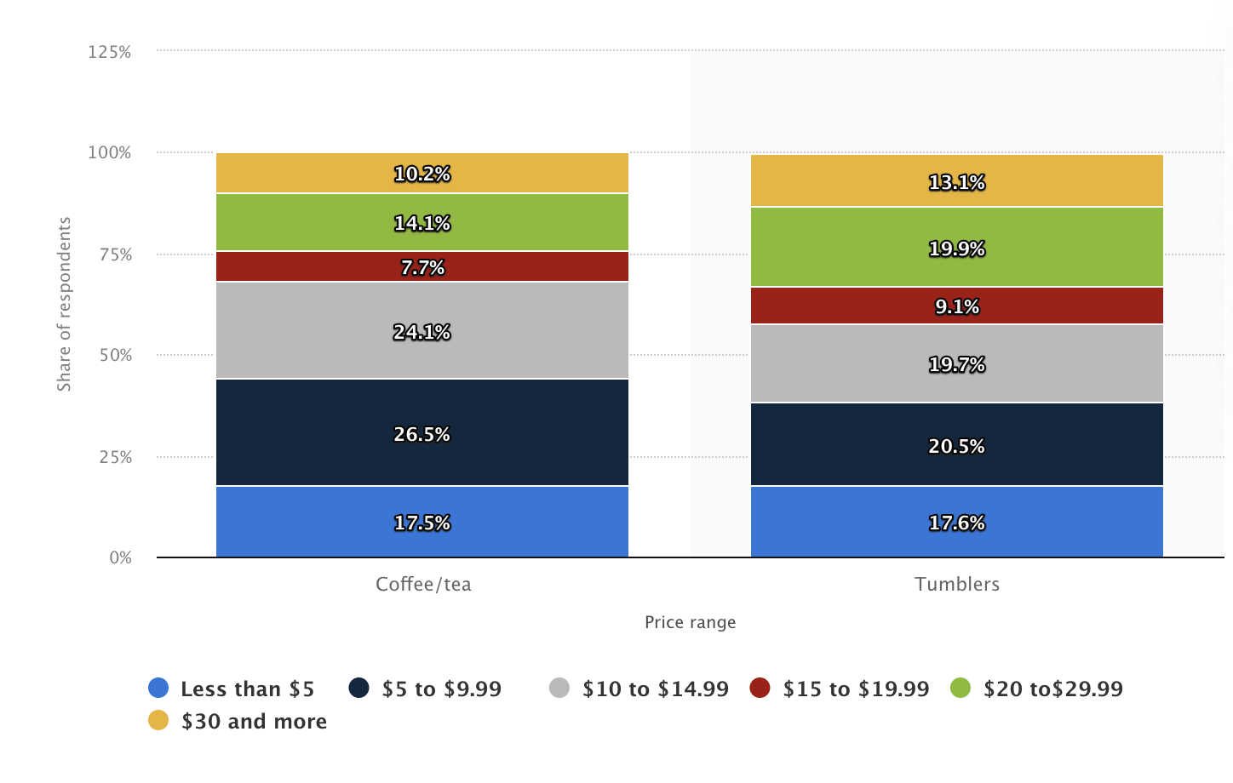
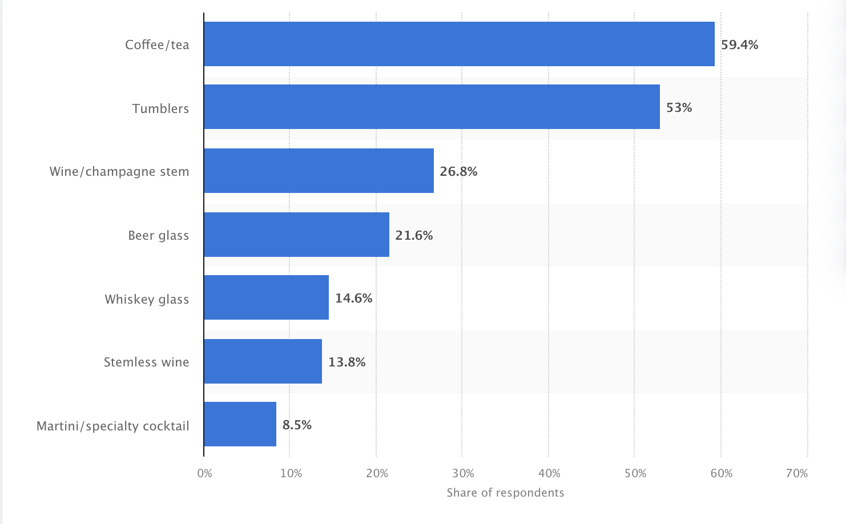
Idea 5:
Beer, coffee and tea are the top beverage products that consumer purchase in glass. Tweets are growing at 7.7% CAGR in the last 5 Years.
53 percent of U.S. consumers would most likely purchase tumblers, if they were to make a glass beverage-ware purchase in the next 12 months.
26.5% of US consumers expect to pay between $5 to $9.99 for coffee/tea , and 20.5% expect to pay between $5 to $9.99 for tumblers.
Wine, beer and coffee are the top 3 keywords about glass in 2021.
Source: Statista 2020, United States; NPD Group; 2020; 2,000 respondents; 18 years and older.

